Slide 1
Supervision in the Receiving State
Presented by: ICAOS DCA Liaison Committee &
Training, Education & Public Relations Committee

Slide 2
Training Objectives
Considerations for responding to pending charges & revocable behavior
Learn about differences in supervision between sending & receiving states
  Share communication tips/best practices

Slide 3
Responding to Pending Charges & Revocable Behavior

Slide 4
What’s important….
Identify and report circumstances of new offense
  Include other revocable behaviors
Prosecuting courts information
  Is the court aware of compact rules and implications?
  Are hearings scheduled? If so, when?
  Has bail been given? If so, how much?
  Is there a condition restricting out of state travel?

Slide 5
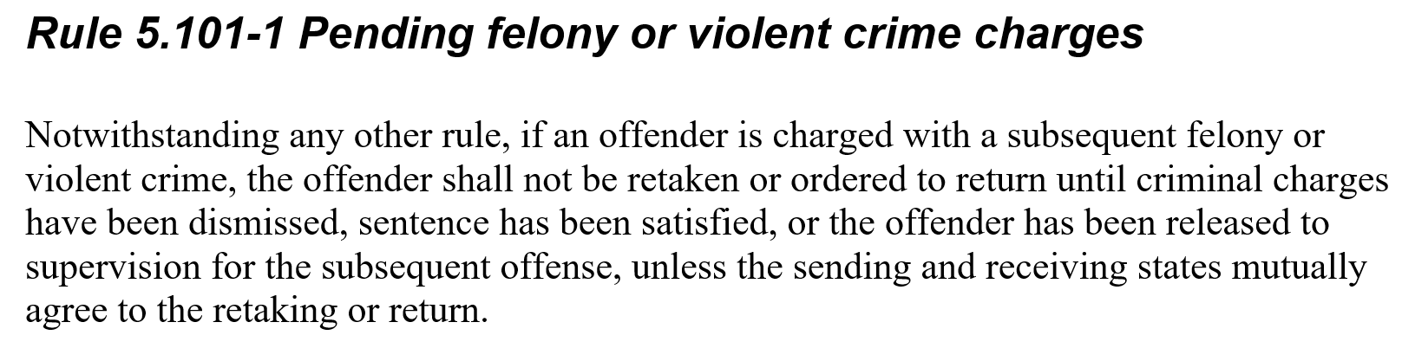

Slide 6
What are the issues?
Path to permanent revocation varies as does what revocation means in definition of ‘behavior requiring retaking’
What differences exist in what is imposed on instate offenders prior to revocation vs a compact offender when considering submission of a ‘violation report requiring retaking’?
Notes:
Ask for examples?
Jacey to provide a brief description of what NE has done

Slide 7
What are the issues?
For some, no authority to supervise offenders when pending charges exist
With the exception of offender’s discharged from supervision by sentencing authority (sending state,) receiving states remain responsible for supervision while the offender remains in the receiving state. See AO 1-2019
Notes:
States who say the ‘can’t supervise’ are in conflict with compact rules. Need to consider legislation, supreme court ruling, etc.

Slide 8
What are the issues?
Some compact offenders (because original sentence is from other state) are afforded bail when an instate offender would be held without bond
The language of Rule 5.101-1 anticipates the exercise of discretion for bail in a receiving state by providing the caveat that the prohibition against retaking an offender subject to pending charges is applicable “unless the sending and receiving states mutually agree to the retaking or return.” See AO 1-2019
Notes:
Does this conflict with ‘supervising as your own’ per Rule 4.101?
Receiving state drives when an offender is ‘available’ for retaking. Stakeholder decision.

Slide 9
Considerations…..
Rule 5.101-1 allows for states to mutually agree to retaking
What stakeholders are involved in the revocation process in your state?
Are the courts notified and educated on the retaking rules when these cases arise?
Is my state truly complying with Rule 4.101? (providing consistent supervision and imposition of incentives and sanctions)
Notes:
Rules do not say retaking ‘can’t occur’ it is more about educating and involving stakeholders in these decisions.

Slide 10
Stakeholder Communication is KEY!
Elevate issues to Commissioner!
Is your legal department or Attorney General aware of your state’s limitations and/or advising on questions related to due process in these cases?
  “How long can an offender be held on new pending charges?”
Has the issue been raised with State Council?
  Consider legislation/State Supreme Court ruling?

Slide 11
Differences in Conditions of Supervision

Slide 12
Sending State
Receiving State
Conditions imposed by sentencing authority
Conditions consistent to a similar instate offender
Communication!!!
Remember! Offender application REQUIRES the offender agree to conditions imposed by BOTH sending & receiving states!

Slide 13
GPS
What if GPS is imposed at sentencing, but not available in receiving state?
What if GPS is available in receiving state, but not imposed on a similar instate offender (due to risk/needs score)?
What if GPS is required for similar offenders in the receiving state, but was not imposed as a condition at sentencing?
Notes:
Natalie & Dori
Roberta example for 2nd bullet
Moore is a NM Parolee (Sex Offender) who is currently being supervised in the state of Washington on both probation and parole. Offender was released from New Mexico Otero County Prison Facility on 07/11/2016. Per original conditions of parole offender was to be on GPS ankle monitor for the duration of his parole. The state of Washington determined offender did not qualify for GPS due to a low scoring of Washington Risk Assessment. Also, the state of Washington does not monitor GPS. It was proposed offender be placed on monitor through a private company, but that was denied due to Washington not being able to monitor the private GPS monitoring system. Our office obtained permission from our New Mexico Adult Parole Board to remove special condition of parole Electronic Monitor/GPS. Offender has been doing well on supervision, maintained stable employment, our state has not received any violations. Please let me know if you may need any further information.

Slide 14
Marijuana
What if sending state prohibits use of marijuana, but is allowed for recreational use in receiving state? Medical use only?
What if receiving state prohibits use of marijuana, but is allowed/or not subject to violation in the sending state?
Notes:
Matt Billinger & Andrew Zavaras-Discuss guidelines from KS/NE in regards to CO
Tanja to describe how WA handles incoming offenders for recreational and medicinal use

Slide 15
Lifetime Supervision
Are sending states effectively communicating what ‘lifetime supervision’ means?
‘Compact’ vs ‘Non-Compact’ Eligible Supervision
  Are there non-monetary conditions requiring monitoring?
Sex Offenders: Lifetime registration vs lifetime supervision
Notes:
Tracy Hudrlik (NY) & Simona Hammond (MO)
NE example
Ms. Cooper was placed on probation in Georgia for Felony Sexual Assault of a Minor. She is listed as a Lifetime Sex Offender Registrant and her probation term is listed as Lifetime as well. Georgia submitted a Transfer Request to Nebraska in 2008, which was accepted under the mandatory Resident Family category. Her Probation Officer submitted regular Progress Reports to Georgia and, after ten years of successful supervision, submitted an additional Progress Report summarizing her progress. Also included in the PR was a request that her Lifetime Supervision status be changed and she be released from probation supervision. The Georgia Probation Officer brought the request to the court, including copies of each Progress Report and the judge entered an order releasing Mrs. Cooper from probation supervision. The Georgia Probation Officer submitted a Compact Action Request with a copy of the signed Order and requested Nebraska submit a Case Closure Notice. Nebraska submitted the CCN marking Early discharge from supervision from sending state. Georgia submitted the Case Closure Notice Reply indicating it was valid and the case was closed in ICOTS. Mrs. Cooper was released from probation supervision; however, she remained on both the Georgia and Nebraska Sex Offender Registries, maintaining the Lifetime status.
Here are 3 cases that are now under Indiana lifetime supervision. The case that I used to drive things through after I took over as the DCA was IO 553857 John, Ackley. After several discussions with former Indiana Commissioner Jane Seigel (who spoke with the national office and other commissioners), and the Indiana State Council, we arrived at the current stance that when an offender turns over from active parole to lifetime parole they no longer meet criteria since we can’t respond to a violation report with a warrant. The counter-argument was that it was still supervision across state lines and whether it invoked the Compact or not.
553857 John, Ackley, convicted of B Felony Child Molesting
Released from Indiana DOC 12/14/13
Transferred to NY 11/5/14
End of active parole was his max date of 3/14/17 (max date)
After nearly a year of discussions and frequent communication with former DCA Felix Rosa in NY we finally closed the case out in January, 2018.
867663 Pace, Michael, convicted of B Felony Child Molesting (x2)
Released from Indiana DOC 10/26/17
Transferred to TX 1/24/19
End of active parole was 4/26/19 (max date)
Requested progress report from TX parole in the month leading up to his move leading up to lifetime parole to give the Indiana agent the most current information
813252 Fenner, Cassandra, convicted of A Felony Voluntary Manslaughter
Released from Indiana DOC 6/5/17
Transferred to TX 10/25/17
End of active parole was 6/5/19 (2 year parole obligation)
Requested progress report in the month leading up to transfer to lifetime parole, relayed current contact info to Indiana agent.

Slide 16
Dual Supervision Cases
Are compact offices ensuring review of offender profile prior to submission of activities to ensure consistency in what is being reported?
For example, what if probation sends an absconder violation report….is parole being consulted prior to transmission to sending state?
NE’s MOU for Dual (concurrent) cases-Parole provides supervision
Notes:
Roberta Cohen (NM) to provide examples
The other example for a dual offender would be Michael Hoffman he was being supervised in TX under both probation and parole violated his probation and PVR was submitted but we had to pull teeth to get the information on parole.
Michael Hoffman NMCD 55864 – ICOTS Offender# 737912 – Texas (Returned to NM)
Peter Ramon NMCD 84425 - ICOTS Offender# 916026 – Texas (Pending ABS)
Kerce, Jessica NMCD 85410- ICOTS Offender# 954960 – Texas (Pending Release
Ms. Stevens was convicted of two Felony Dangerous Drugs-Amphetamine Possession in Nevada. She was placed on both Parole and Probation with a Supervision Start date of 04/27/15 for both cases. However, the Parole Supervision End Date was in 2019, while the Probation Supervision End Date was in 2022. She was a Resident of Nebraska within the meaning of the Compact and both of her Transfer Requests were submitted to Nebraska. Nebraska is a bifurcated with Parole and Probation being part of separate branches of government, thus having separate Compact Offices. When both Transfer Requests were received, it was noted she would have a dual supervision case. In Nebraska, rather than having a client report to both a parole officer and a probation officer, a Memorandum of Understanding has been signed by both Compact Offices agreeing that when a client has dual concurrent supervision, the client will be supervised by Nebraska Parole. When Mrs. Stevens’ parole supervision ended in 2019, the supervision by Nebraska Probation began. In ICOTS, a Progress Report was submitted by the Parole Officer indicating Mrs. Stevens would now be supervised by Probation. A member of the Parole Compact Office reassigned supervision of Mrs. Stevens case to a member of the Probation Compact Office, who in turn reassigned supervision to a local probation office. The Parole case was closed in ICOTS, while the Probation case continued.

Slide 17
Supervision Documentation
Progress Report
Violation Report REQUIRING RETAKING
Keeps the sending state informed of supervision practices; offender’s progress and behavior
Invokes requirement for sending state to retake offender
Communication!!!
THINK: “What are you documenting in your own state’s case management?” Keep the Sending State INFORMED!

Slide 18
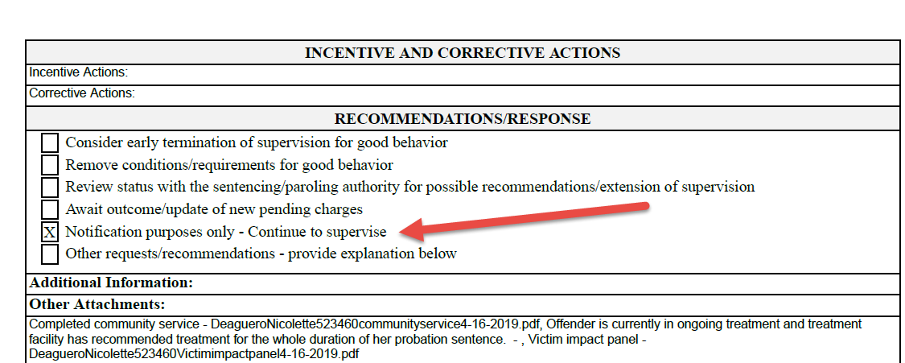
Information ONLY Progress Report
Notes:
Roberta Cohen (NM) to provide examples of Progress Reports “information only”

Slide 19
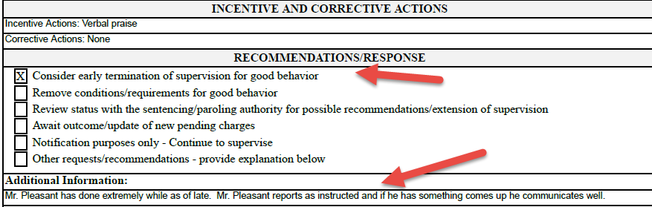
Information ONLY Progress Report
Notes:
Roberta Cohen (NM) to provide examples of Progress Reports “information only”

Slide 20
Violation Requiring Retaking Reporting Considerations
The sending state is only going to know what you tell them
Use the same detail if reporting to your own authorities
Specifics on how the behavior was determined to be revocable
Has the option of working with the offender (e.g. intervention) been exhausted?
Notes:
Jacey/Tracy: Check-in of where states are with 2017 Rule amendments ensuring consistent supervision-Are states continuing to see better documentation, retakes when warranted, barriers imposing sanctions like instate offenders?
Dara Matson (IL) to provide examples of cases where RS did not provide sufficient documentation for IL to conduct violation/revocation hearing after retaking; where are these cases now? Stay in IL/was able to get needed documentation/back under supervision in RS after retake

Slide 21
Questions

Slide 22

