Slide 2
Committee Reports
October 11, 2017

Slide 3
ABM Workgroup Report
Jeremiah Stromberg, Vice-Chair
Oregon

Slide 4
ABM Workgroup
Chair: Jeremiah Stromberg, OR
Members:
Michael Potteiger, PA
Suzanne Brooks, OH
Matt Billinger, KS
Natalie Latulippe, CT
Margaret Thompson, PA
Shawn Arruti, NV
Mark Patterson, OR
Jenna James, GA
Elizabeth Powell, DC

Slide 5
Purpose
Recommend an Agenda to the Executive Committee for the next ABM
Review feedback from previous ABMs, Region Meetings, and additional input
Consider emerging trends in supervision
Support for Hosting State
Develop engagement activities

Slide 6
Requirements for Participation
1 Face to Face Meeting in Winter (someplace warm!)
2-3 WebEx Meetings in Spring
Some offline planning / development
Creative
Willing to bring new ideas

Slide 7
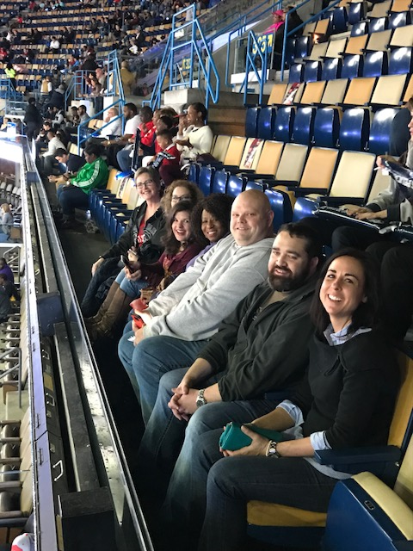

Slide 8
Information Technology Committee Report
Gary Roberge, Chair
Connecticut

Slide 9
Information Technology Committee
Chair: Commissioner Gary Roberge, CT
Vice-Chair: Commissioner Nancy Ware, DC
Committee Members
Commissioner Chris Norman, AL
Commissioner Sheila Sharp, AR
Commissioner Shawn Arruti, NV
Ex-officios
DCA Natalie Latulippe, CT
DCA Matt Billinger, KS
DCA Candice Alfonso, NJ
DCA Felix Rosa, NY
DCA Julie Lohman, VA

Slide 10
ICOTS System Update
2017 Rule Amendments
Implementation of ICOTS system modifications in June 2017
Managed progress report process
Modification to the violation process (Behavior Requiring Retaking)
Offender Photo Quality Project
Audit

Slide 11
ICOTS Cont’d
ICOTS Helpdesk Tickets Created:
FY 2015 | FY 2016 | FY 2017
2,000 | 929 | 800
23% less than 2014 | 53% less than 2015 | 14% less than 2016

Slide 12
ICOTS (Cont’d)
ICOTS Helpdesk FY 2017
TICKET GROUP | FULL RESOLUTION TIME (HRS) [MDN] | # SOLVED TICKETS
1. Level Support | 26 hours | 562
2. ISG Support | 311 hours | 234
3. Known Issues | 11,394 hours | 81
4. External Reports | 76 hours | 22
5. ICAOS Website | 11 hours | 12
6. ICOTS VINEWatch | 139 hours | 5

Slide 13
ICAOS Website
New and Improved!
New Vendor
Cost effective
Mobile Friendly
Secure Connection
Tabbed Navigation
Interactive US Map
Improved Site Search

Slide 14
ICAOS Website
Web Traffic
Visits up 9.4%
Mobile visits up 34%
WEBSITE VISITS
FY 2015 | FY 2016 | FY 2017
512,261 (11% more than FY 2014) | 524,922 (2.5% more than FY 2015) | 574,540 (9.4% more than FY 2016)

Slide 15
IVINS ICOTS Victim Notification Information Service
Provides victims with timely information
Victims receive notification for certain status changes
Address change
Leaves state
Engages in behavior requiring retaking
New name for VINEWatch
New anonymous self- registration option
available Fall 2017

Slide 16
IVINS Anonymous Registration
Phase 1
(implemented Sept 2017)
Phase 2
(TBD-expected late 2017)
New web portal for victims to self-register
Victims can manage phone, text and email registrations
States responsible for assisting victim’s with registration when needed
Explaining notifications
Assisting with notification management, etc.
Revised scripts for notifications
Designated victim rep group to approve notifications

Slide 17
FY 2018 ICOTS Enhancements
RELEASE RANK | RELEASE | # OF ENHANCEMENTS | HOURS
1 | More Attachments / VREP & CCN (Attachment sections for RFRI, TREQ, CCN) | 5 | 204
2 | General Offender Profile (“Tolled” functionality + “CONFIDENTIAL RECORD” indicator) | 2 | 165
3 | Workflow Control (Comments as case notes, case note notifications + restrict duplicate activities) | 5 | 144
4 | New Processes (Subsequent State Transfer & Rejected Cases) | 2 | 174
5 | TREQ and RFRI Changes (Move application to end of list, Counts for NCIC offenses, text field for gang “other”) | 6 | 60

Slide 18
Looking Forward
Offender Photo Quality
Review photo quality based on newly adopted standards in the ICOTS Privacy Policy
Start with new photos added after July 1, 2017
NCIC Warrant Information
Matthew Billinger, DCA Kansas
ICOTS Enhancements
IVINS Testing
Privacy Policy
ICOTS Data Exports
Notes:
d

Slide 19
Training, Education & Public Relations Committee Report
Anne Precythe, Chair
Missouri

Slide 20
Training, Education & Public Relations Committee
Chair: Commissioner Anne Precythe, NC
Committee Members
Commissioner Dara Matson, IL
Commissioner Chris Moore, GA
Commissioner Scott McCaffrey, ME
Commissioner Roberta Cohen, NM
Commissioner Russell Marlan, MI
Commissioner James Parks, VA
Commissioner Joseph Clocker, MD
Commissioner Hope Cooper, KS
Ex-Officios
DCA Sally Reinhardt-Stewart, NE
DCA Timothy Strickland, FL
DCA Mark Patterson, OR

Slide 21
FY2017 Trainers
Margaret Thompson (PA)
Leslie Thomas (NC)
Betty Payton (NC)
Ernette Griggs (WI)
Holly Kassube (IL)
Shawn Arruti (NV)
Judy Mesick (ID)
Matthew Reed (PA)
Julie Lohman (VA)
Jacey Nordmeyer (NE)
Matthew Billinger (KS)
Dori Littler (AZ)
Sally Reinhardt-Stewart (NE)
Joe Beaman (MI)
Tracy Hudrlik (MN)

Slide 22
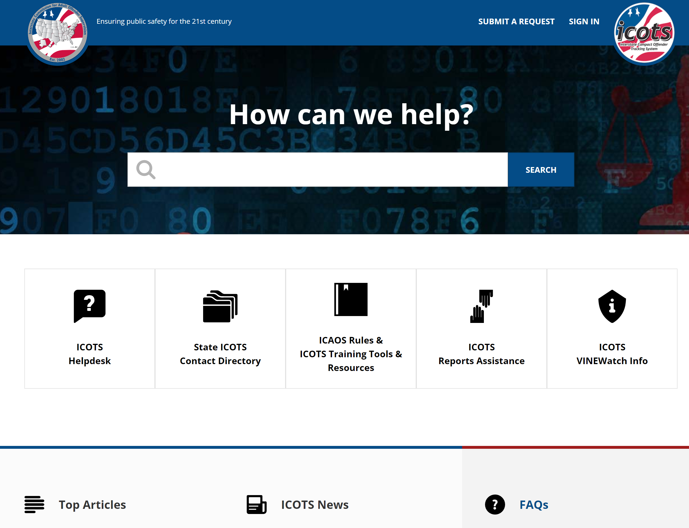
This Years Accomplishments
Over 4,000 individuals trained
Compact Staff: December 2016 & May 2017
General Rules: Webex & Ondemand
APPA-NYC (Promoting a Single Standard for Supervision)
Newly redesigned ICAOS Support

Slide 23
DCA Calls
Impact of June 1st amendments varied as do supervision practices
Ensure states are (or working towards) exhausting all efforts to correct compliance prior to requiring retaking
Issues identified:
PC hearing requirements
Reporting jail time used as a sanction
Definition of behavior requiring retaking
State sponsored programs used in rehabilitation not offered to interstate offenders
Stakeholder involvement/overcoming resistance
Documentation consideration-ONLY use Violation Reports at the time RETAKING IS REQUIRED!

Slide 24
Training Plans FY2018
Calling on Trainers!!
ICOTS Trainings
New enhancements
New reports and data clean up
2018 Amendment Training
Probable Cause & Violation Documentation
Supervision Responsibilities
Share ideas/provide TTA to states working on stakeholder involvement
Notes:
Mindy will send email to request volunteers to help with this years training efforts. We will be doing a variety of Webex’s newslettlers and TTA if/when requested.

Slide 25
Training Committee Support
The next level of training….know MORE than the rules!
Share solutions!
Commissioners ensure DCAs have avenue to train stakeholders on IMPLEMENTATION of the rules for your state!
State Council
USE THEM!

Slide 26
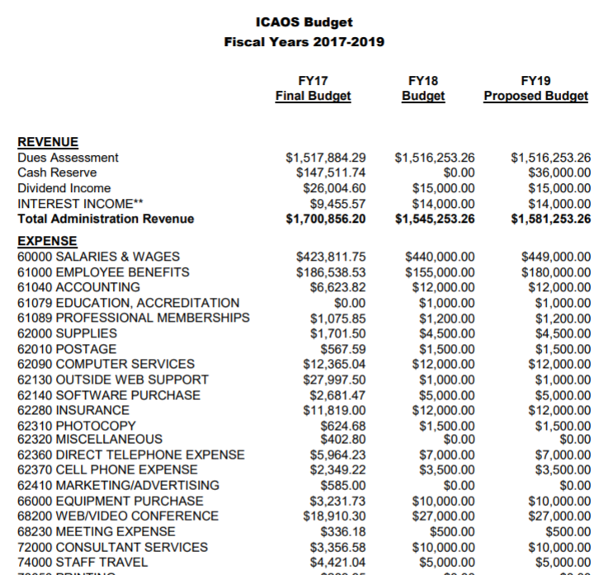
Finance Committee Report
Charles Lauterbach, Chair
Iowa

Slide 27
Finance Committee
Chair: Commissioner Charles Lauterbach, IA
Committee Members
Commissioner Christy Gutherz, MS
Commissioner Sheila Sharp, AR
Commissioner Melissa Roberts, CO
Ex-Officio
DCA Debbie Duke, TN

Slide 28
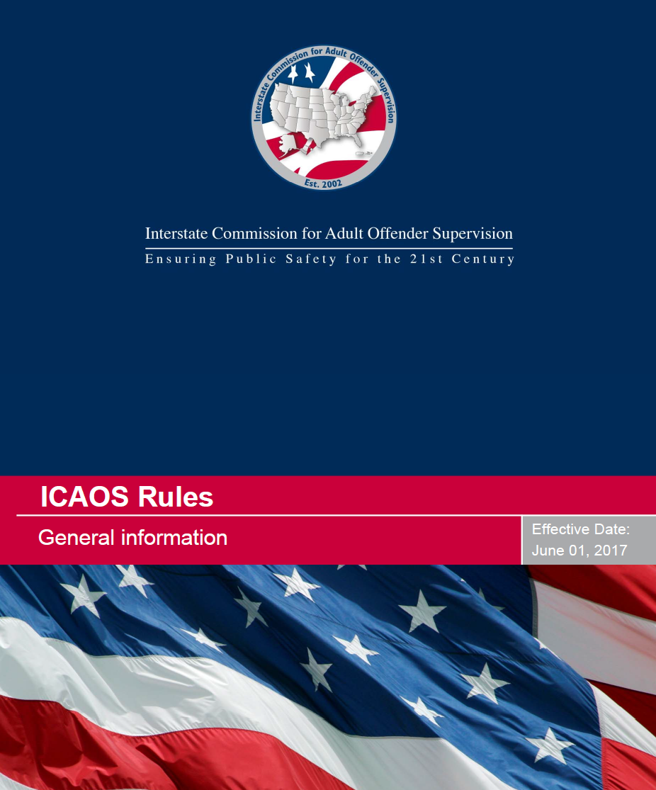
Rules Committee Report
Jane Seigel, Chair
Indiana

Slide 29
Rules Committee
Chair: Commissioner Jane Seigel, IN
Committee Members
Commissioner Dori Littler, AZ
Commissioner Jenny Nimer, FL
Commissioner Chris Moore, GA
Commissioner Bob Maccarone, NY
Commissioner Doug Clark, SD
Commissioner Coltan Harrington, WY
Commissioner Shawn Arruti, NV
Commissioner Libby Elliot, TX
Ex-Officios
DCA Tim Strickland, FL
DCA Margaret Thompson, PA
DCA Tracy Hudrlik, MN
DCA Pat Odell, WY

Slide 30
New Guide!
Idea for Rule or Amendment?
Not sure where to start?
New guide provides draft template and outlines ICAOS’s rule/amendment adoption process from draft to final action
Notes:
Available for download from rules committee page on icaos website.

