Slide 1
Attacking Actuarial Risk Assessment Instruments—Precision and Bias
Interstate Compact for Adult Supervision Annual Business Meeting
Cleveland, September, 2016
Christopher T. Lowenkamp, Ph.D.
Social Science Analyst
Administrative Office of US Courts

Slide 2
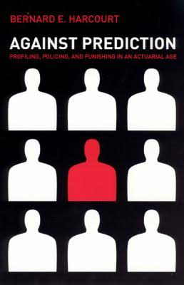

Slide 3


Slide 4
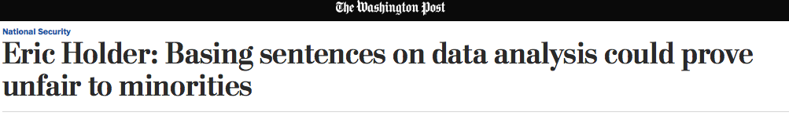

Slide 5
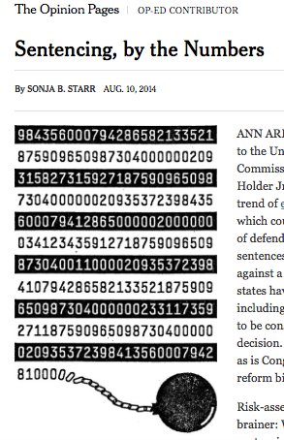

Slide 6


Slide 7


Slide 8
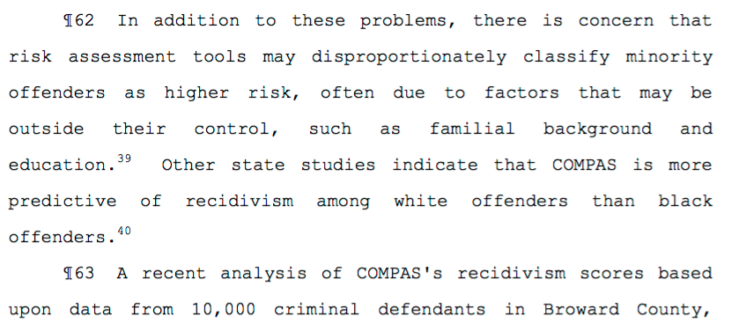

Slide 9
Two Basic Concerns Lodged
Actuarial Risk Assessment Instruments (ARAI) don’t do what they are supposed to do
Cooke & Hart
Starr
Harcourt (lesser extent)
ARAIs do what they are supposed to do but they are biased
Holder
Starr
ProPublica
O’Neil

Slide 10
But…
With many of the articles and books written the discussion is absent data
The one article that contains data is seriously flawed and the authors failed made decisions that, from a research perspective, are unehtical

Slide 11
How Science Takes Stock
“The reward system of science greatly influences the potential for disagreement.”
- Hunt (1999:5)

Slide 12
The Wildly Imprecise Argument
“The ARAIs cannot be used to estimate an individual’s risk for future violence with any reasonable degree of certainty and should be used with great caution or not at all.”
            - Hart, Michie & Cooke (2007:60)
“I show that they provide wildly imprecise individual risk predictions…”
- Starr (2014:803)

Slide 13
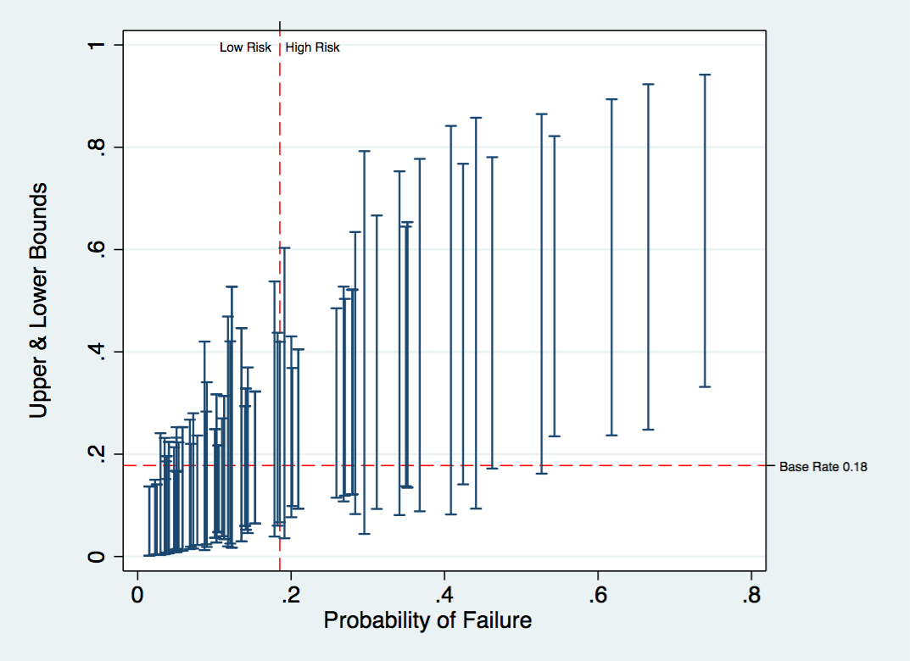
Wildly (Im)Precise

Slide 14
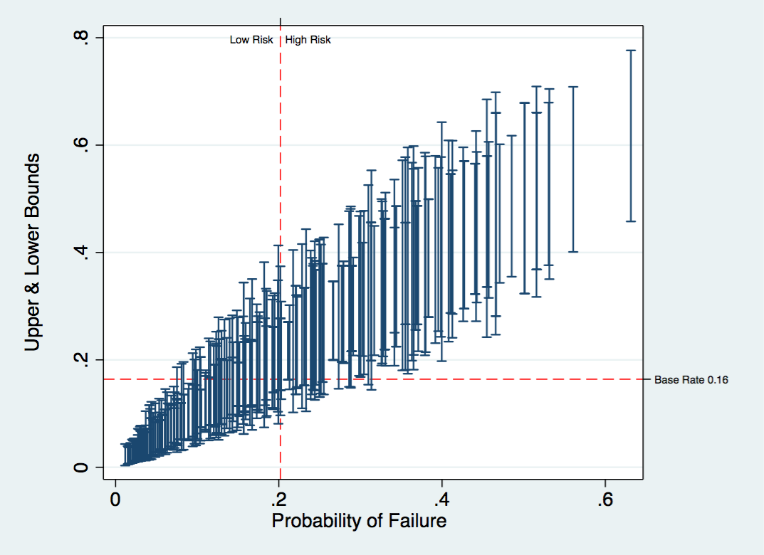
Kind of (Im)Precise

Slide 15
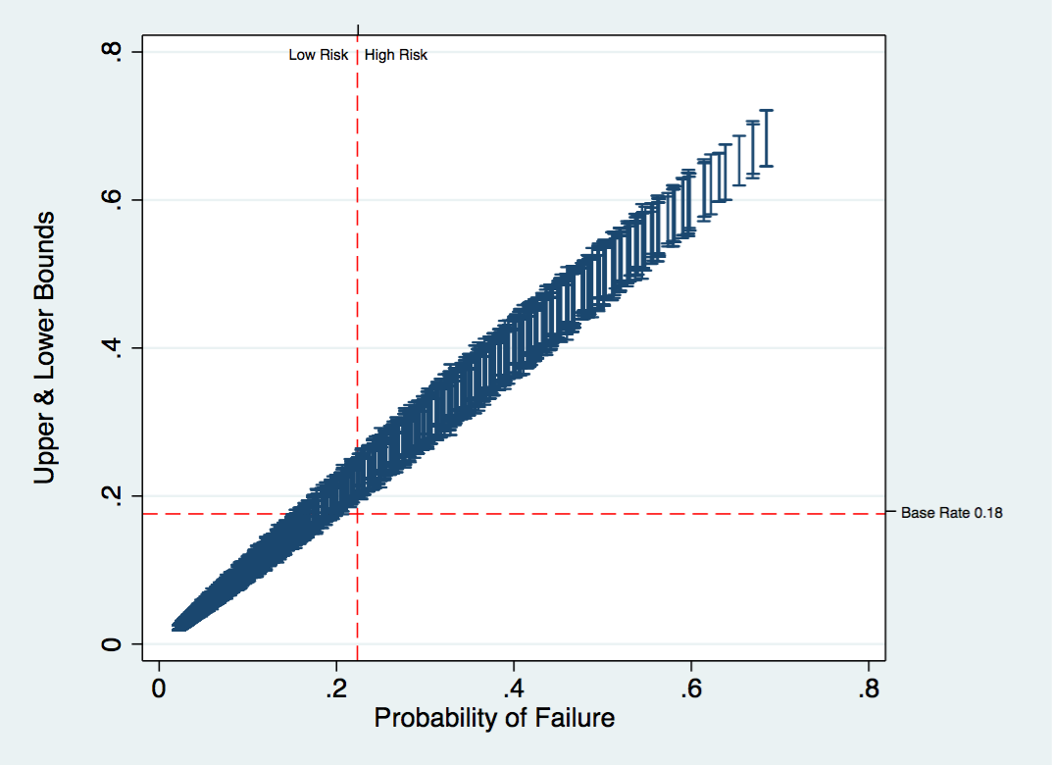
Wildly Precise

Slide 16
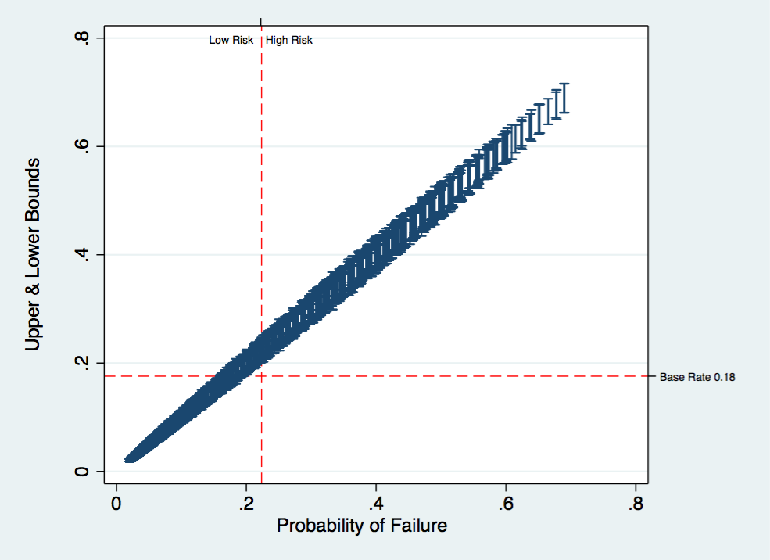
Wildly Precise²

Slide 17
If You Want Someone More Qualified
The relative weights to give such varied considerations are properly functions of social policy, not statistical inference. We conclude that while proponents and detractors of ARAIs may have cogent arguments to debate and for policymakers to weigh, [Cooke, Hart, and Michie’s] specious statistical demonstrations are not among them.
-Imrey & Dawid, 2014

Slide 18
The Bias Argument
Punishment profiling will exacerbate these disparities — including racial disparities — because the risk assessments include many race-correlated variables. Profiling sends the toxic message that the state considers certain groups of people dangerous based on their identity.
-Starr, 2014

Slide 19
The Bias Argument
Sentencing decisions based on “static factors and immutable characteristics,” Holder said, “may exacerbate unwarranted and unjust disparities that are already far too common in our criminal justice system and in our society.”
-Holder, 2014

Slide 20
The Bias Argument
Machine Bias-There’s software used across the country to predict future criminals. And it’s biased against blacks.
-Angwin, Larson, Mattu & Kirchner, 2016

Slide 21
How To Test For Testing Bias
Degree of Prediction
Form of Prediction
Series of studies based on race, gender and ethnicity using the PCRA
Replicated ProPublica results
Study of race bias on LSI-R

Slide 22
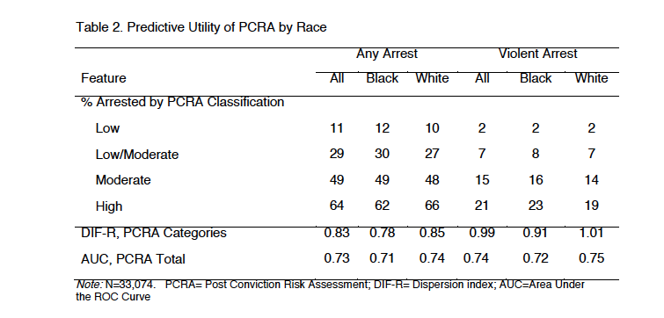
Failure Rates By PCRA Category & Race

Slide 23
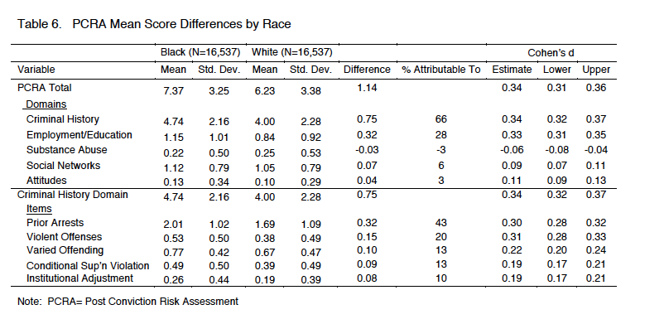
Mean PCRA Scores By Race

Slide 24
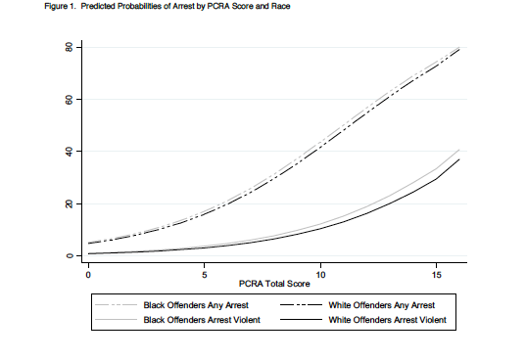
Predicted Probabilities by PCRA Score

Slide 25
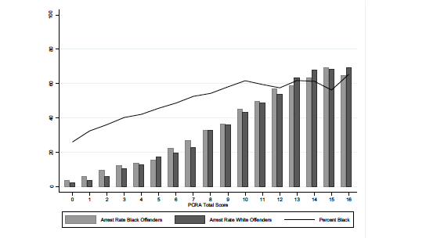
Actual Re-arrest Rates by PCRA Score and Race

Slide 26
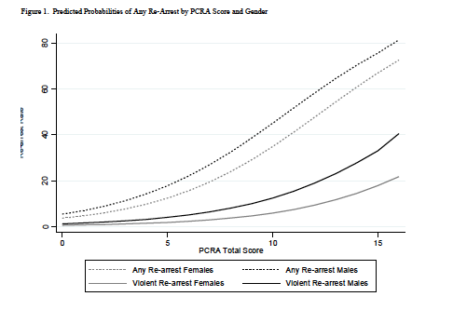
Predicted Probabilities by PCRA Score & Gender

Slide 27
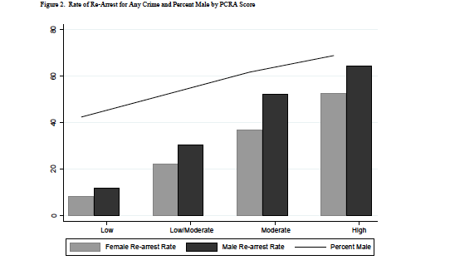
Actual Re-Arrest Rates by PCRA Category & Gender

Slide 28
Predicted Probabilities & Actual Re-arrest Rates by PCRA Score & Ethnicity

Slide 29
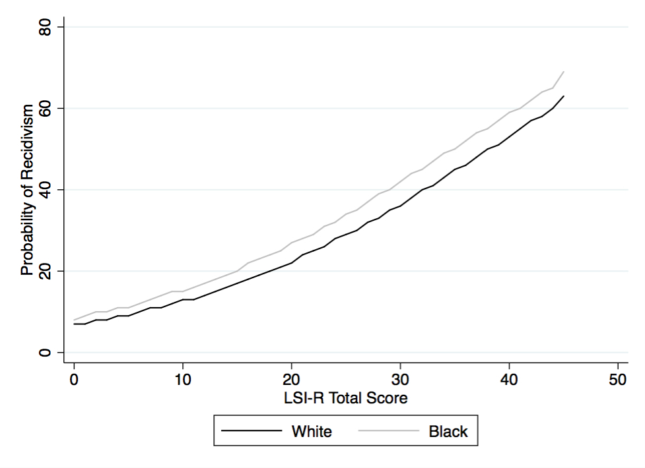
Predicted Probability of Recidivism by LSI-R Score & Race

Slide 30
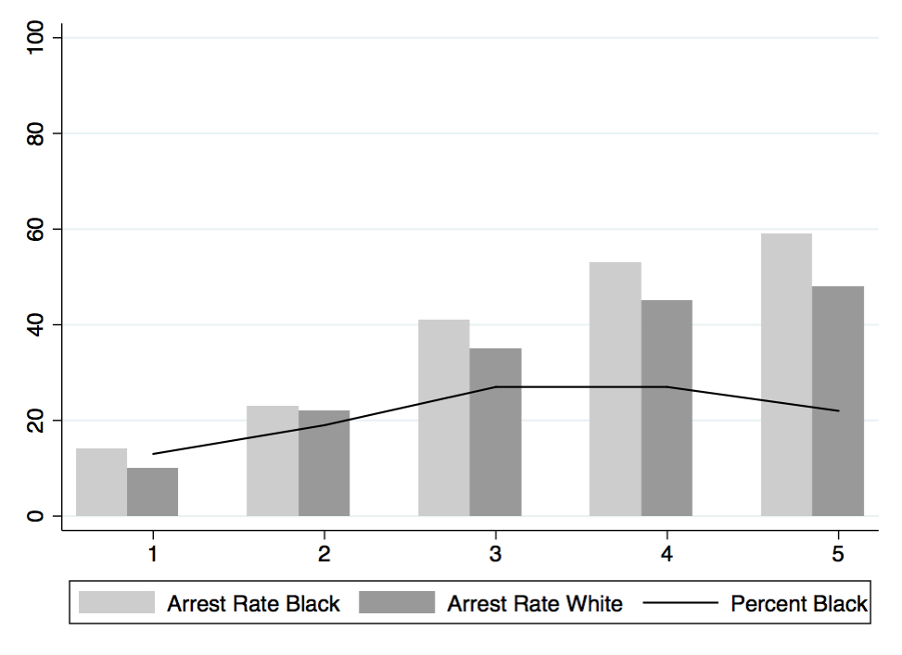
Actual Recidivism Rates by LSI-R Category & Race

Slide 31
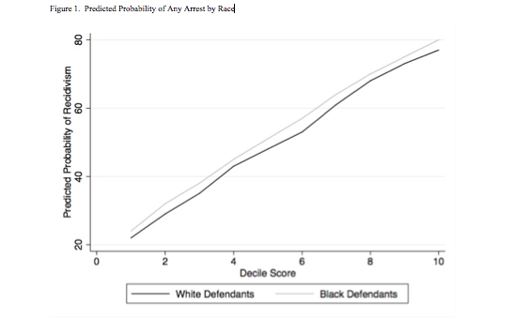
Predicted Probability of Re-arrest By COMPAS Decile Score & Race

Slide 32
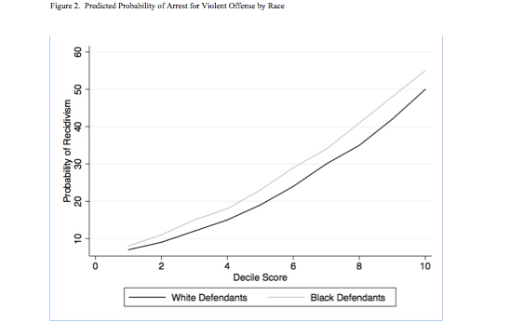
Predicted Probability of Re-arrest for Violent Offense by COMPAS Decile Score & Race

Slide 33
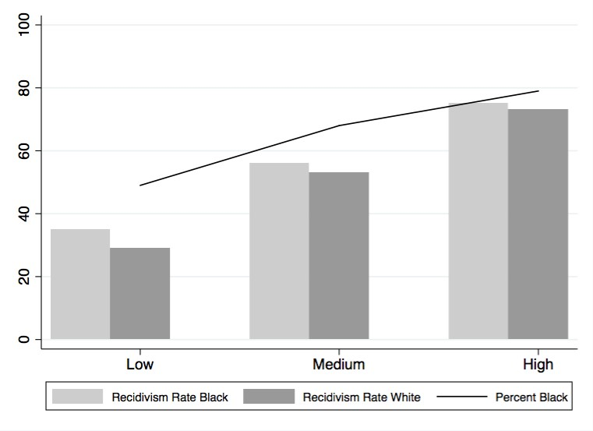
Actual Re-arrest Rate by COMPAS Risk Category & Race

Slide 34
Overall
Tested for racial bias in risk assessment. Found no bias across:
Three different risk assessment
Multiple samples
Federal, state, and local jurisdictions
Tested for gender bias in risk assessment. Did find slope bias. This is easy to correct for.
Tested for ethnicity bias in risk assessment. Found no bias.

Slide 35
Why Does It Matter?
The validity and intellectual honesty of conducting and reporting analysis are critical, since the ramifications of published data, accurate or misleading, may have consequences for years to come.
-Marco and Larkin, 2000, p. 692

